Slide 1
Moneyball Club Winter Quarter ‘20
Workshop Series: Predicting MLB MVP Odds
Part 1: Webscraping Wikipedia for MVP Players

Slide 2
Topics we wIll Go OVER
Why do we need to webscrape?
What is webscraping?
Let’s get started: How do we webscrape?
Import Packages
Get URL
Inspect Page and Identify what to extract
Extract the data
Store the data

Slide 3
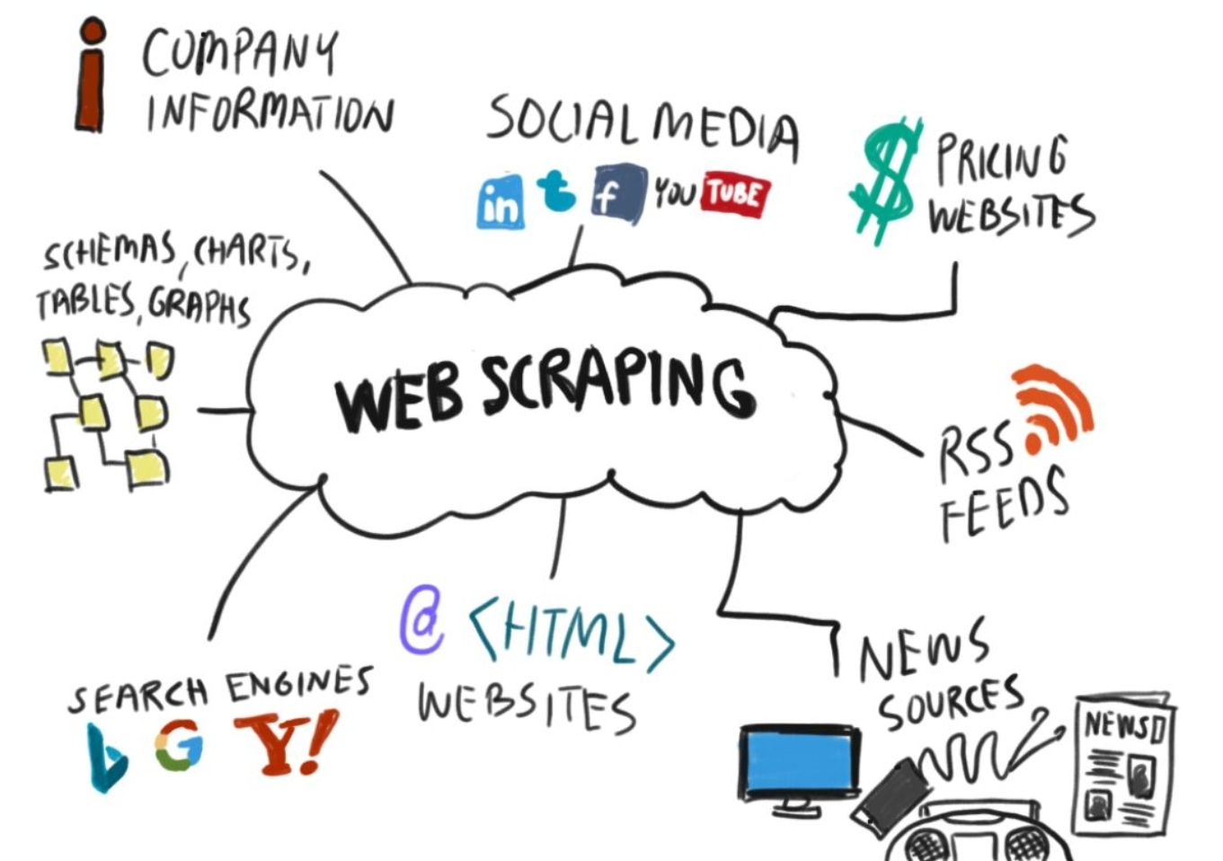
Why Do we Webscrape?
Purpose:
Collect Information from a website
When to use:
Data is not readily available
Applications:
Price comparison,
Email address gathering,
Social Media,
Job Listings,
Housing,
Sports!

Slide 4
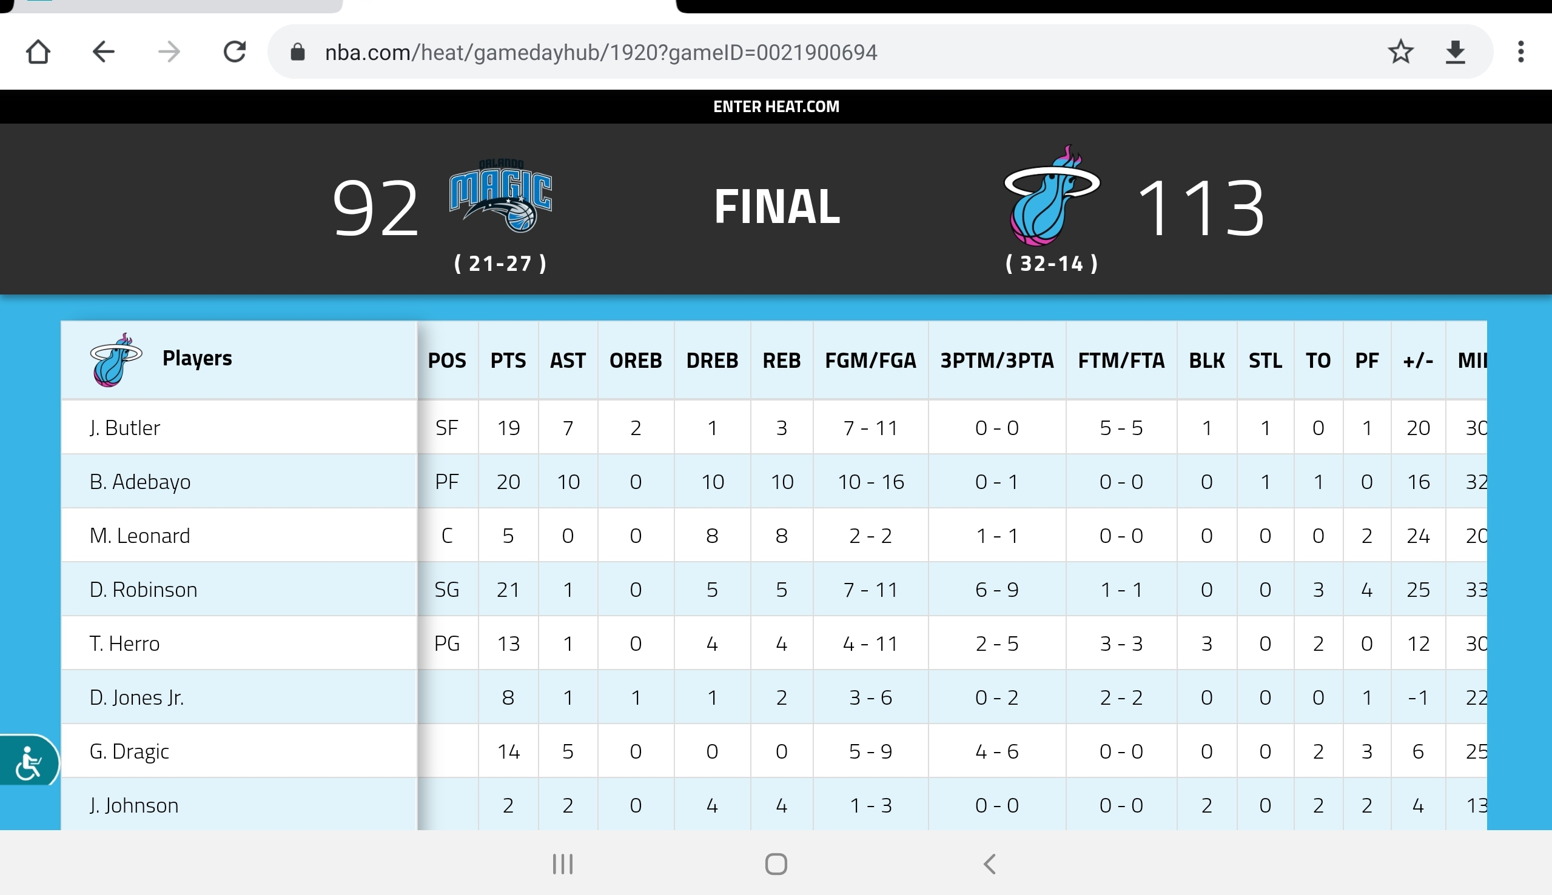
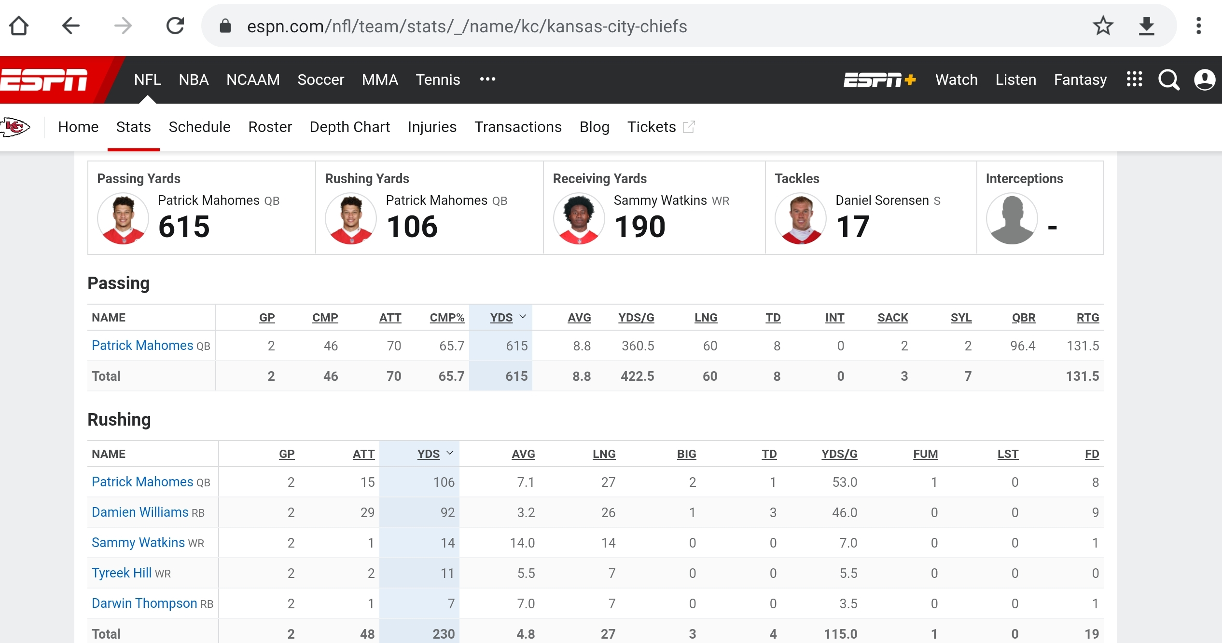
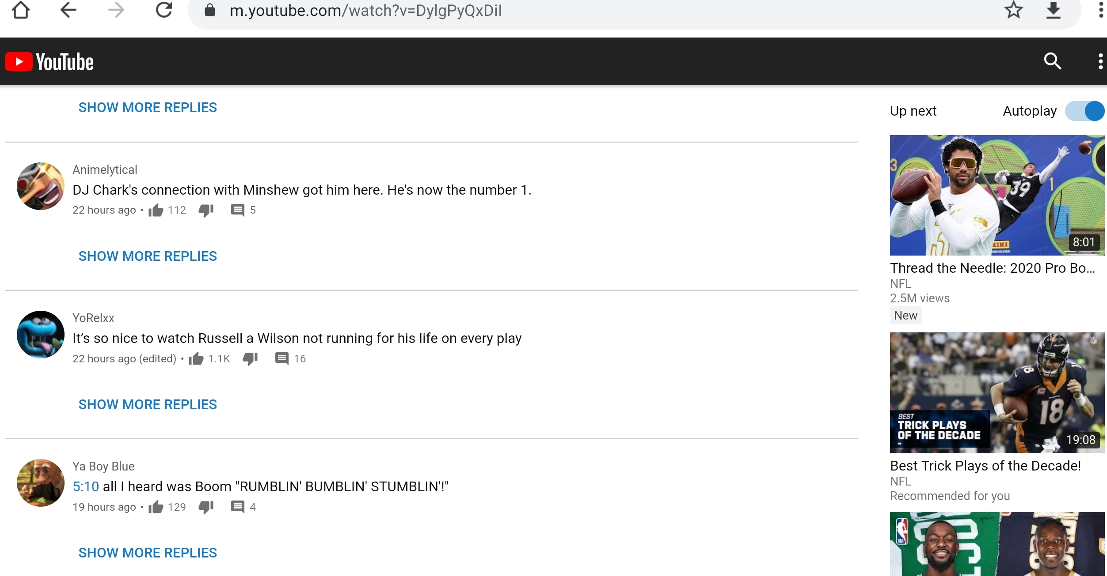

Slide 5
Problem
You really wanna get an internship this summer. The job fair is coming up. You look at your resume, and what do you find? Your project section is empty! So you begin to think about what kind of project you want to do. And you come across the idea of predicting the odds of future MVP players. You now begin to search online to find who the past MVP players are. You search for nice excel files that contain the data on the MVP players, but no luck. So what do you do now? Should you manually type all MVP players for the past century, do you give up and try a new project? Moments before giving up, you come across a Wikipedia page that contains everything you need! But how do you get this data?
Link : https://en.m.wikipedia.org/wiki/Major_League_Baseball_Most_Valuable_Player_Award

Slide 6
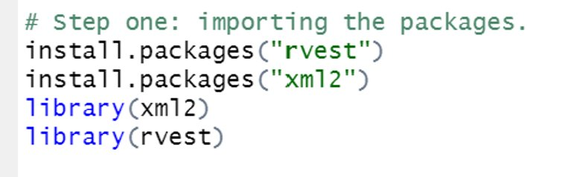
Step 1: Import Modules
Difficulty: Easy
English: "Take code someone else use and use it for yourself"
Purpose: Use already existing code to do the work (“Someone wrote instructions, you just got to tell someone else what they are”)

Slide 7
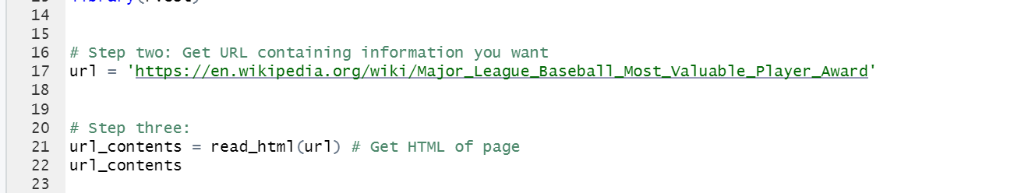
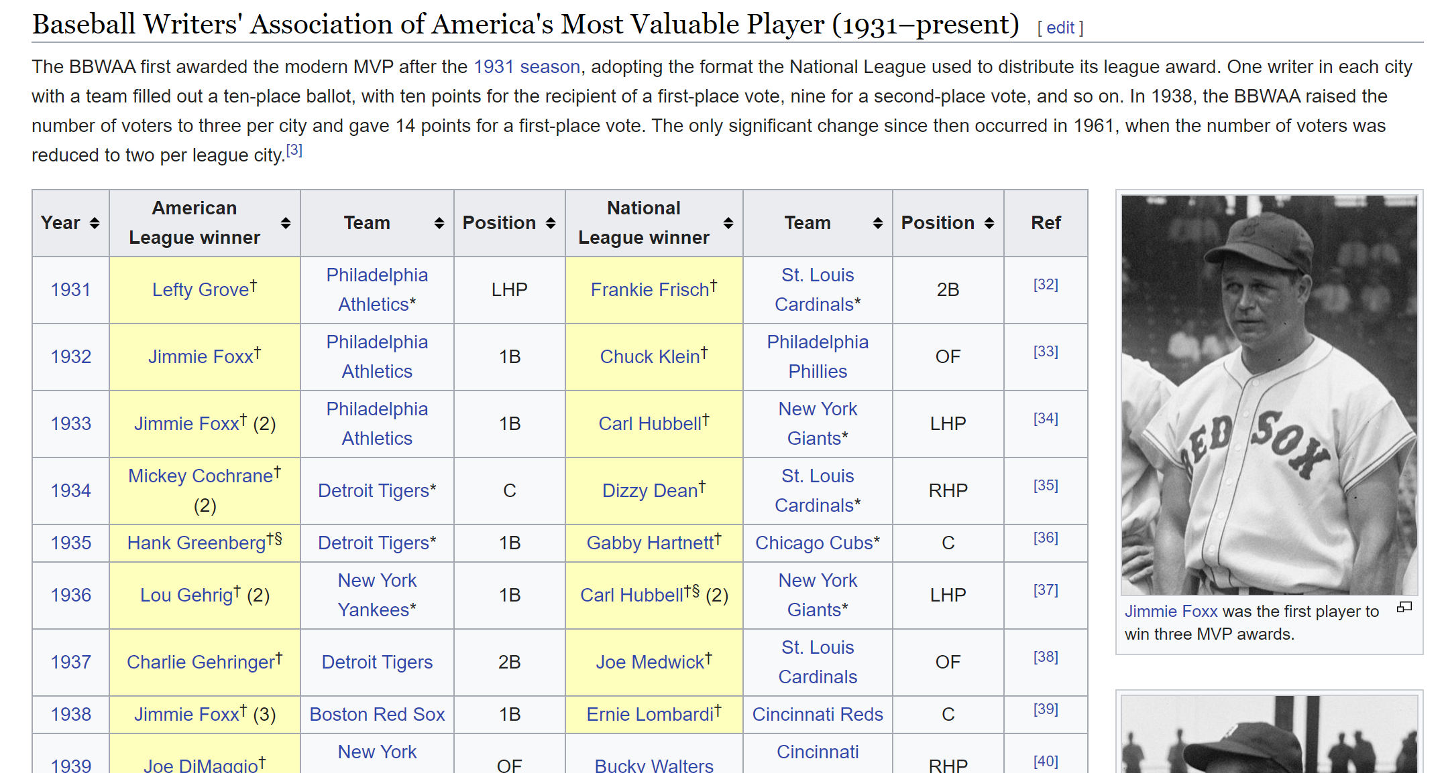
Step 2: Get Website HTML Contents
Difficulty: Very Easy
Purpose: Finding the data you want to extract
Source: https://en.wikipedia.org/wiki/Major_League_Baseball_Most_Valuable_Player_Award

Slide 8
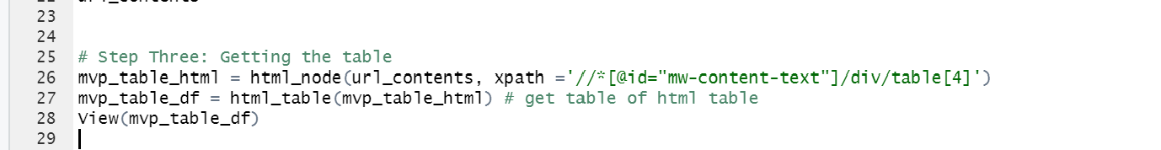
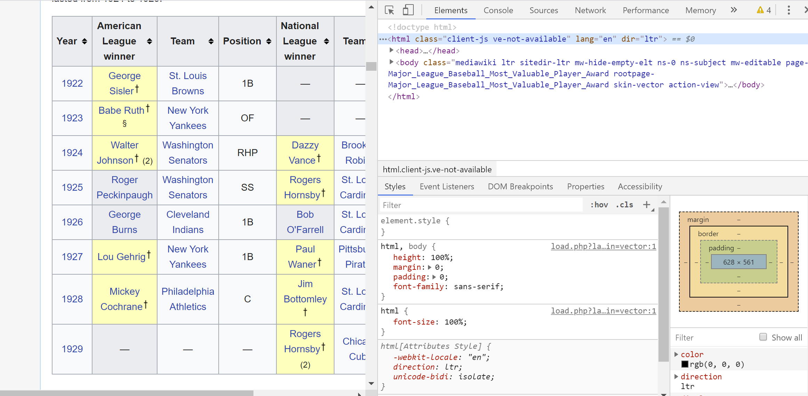
Step 3: Get Table
Code Reference:
Difficulty: Looks Hard, but easy
Purpose: Convert from html to data frame
Step 1: Inspect
Step 2: Find Table
Step 3: Get path to HTML Node (element)
Picture Reference:

Slide 9
Reflection
1) What are some pros of webscraping?
2) When should we not webscrape?
3) Is there more to webscraping?

Slide 10
Resources
Python:
https://www.crummy.com/software/BeautifulSoup/bs4/doc/
https://selenium-python.readthedocs.io/
R
https://towardsdatascience.com/learn-to-create-your-own-datasets-web-scraping-in-r-f934a31748a5
Tip : Towards Data Science Blogs (View Incognito)

Slide 11

What's NExt

Slide 12
Challenge
From the wikipedia page containing the NBA MVP since 1955-56 to present day. Extract this table into a dataframe in R.
Remember the steps:
Import Modules
Get Website HTML Contents
Get Table
https://en.wikipedia.org/wiki/NBA_Most_Valuable_Player_Award

